Slide 1
台灣醫療影像資訊標準協會 FHIR生理監測及醫學影像跨院互通研討會 發展台灣 FHIR Connectathon 建議
合華科技股份有限公司
李祥豪 副總經理
台灣醫學資訊學會秘書長
2019/5/23

Slide 2
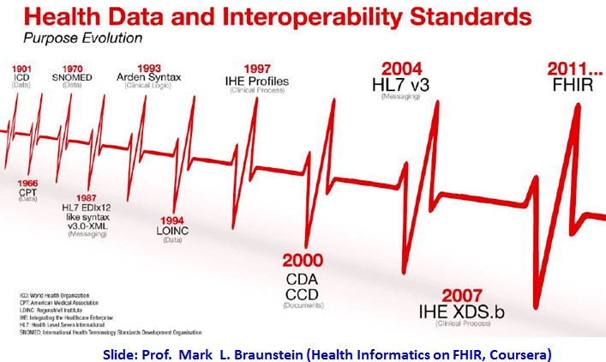

Slide 3
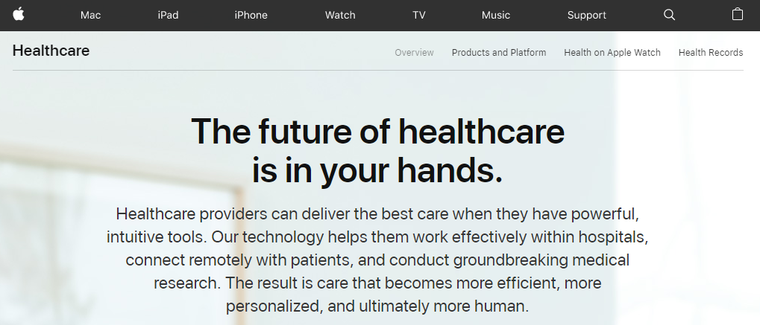
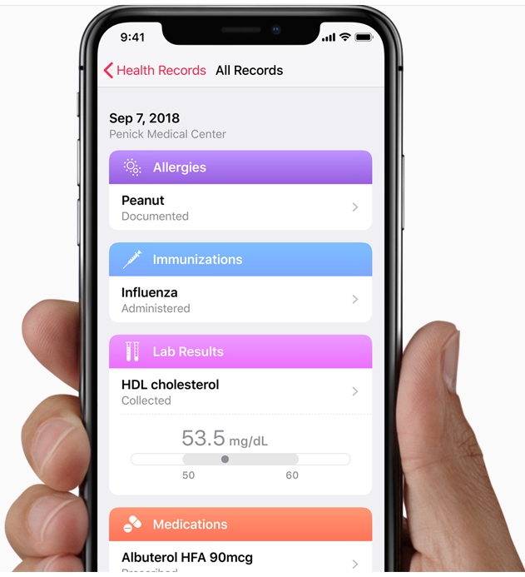
Institutions that support health records on iPhone about 272+ US hospital systems
Personal Health Record (PHR) based on FHIR

Slide 4
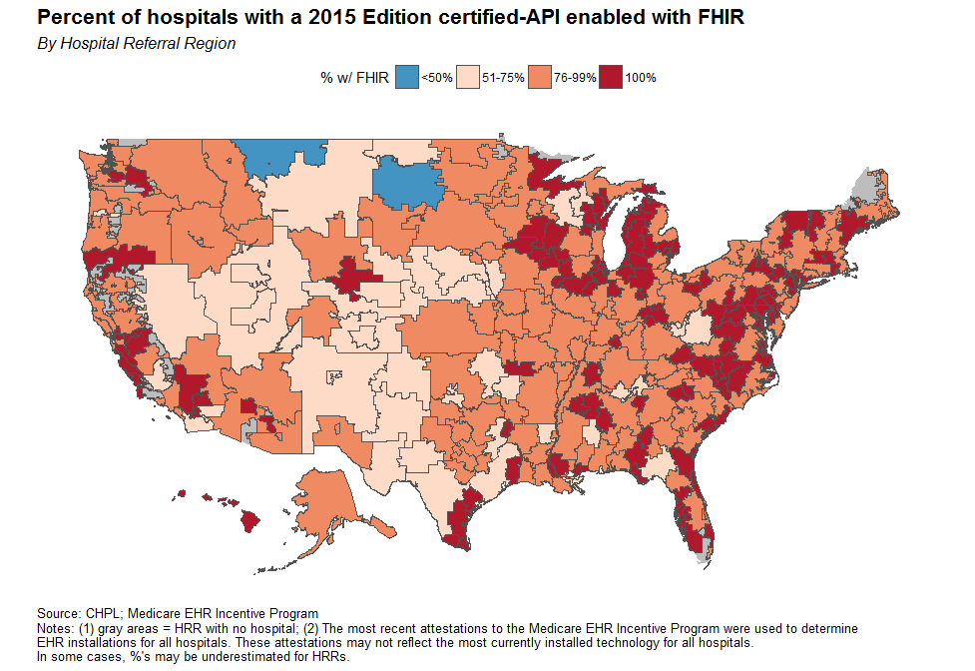
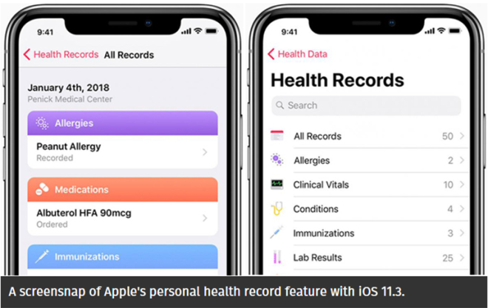
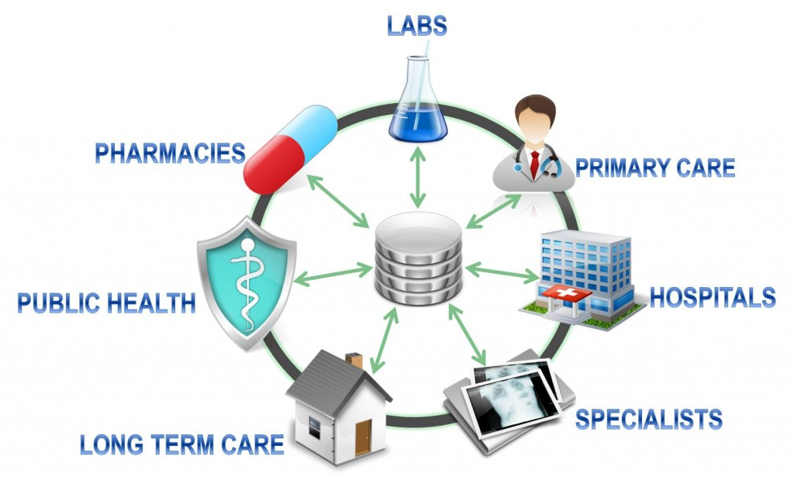
美國FHIR發展概況
FHIR
美國iPhone用戶已能歸人互通
全美272家醫療集團之EHR
可由個人授權給指定的第三方 服務單位存取運用完整的PHR
以提供有效的連續性整合照護
全美逾80%健康照護機構/廠商
支援以FHIR跨機構互通EHR
區域自訂健康資料互通範圍
與隱私/資安授權政策
ONC Argonaut Project FHIR基礎建設
區域/聯盟互通規範
下一代
健康照護應用 & AI
Connectathon

Slide 5
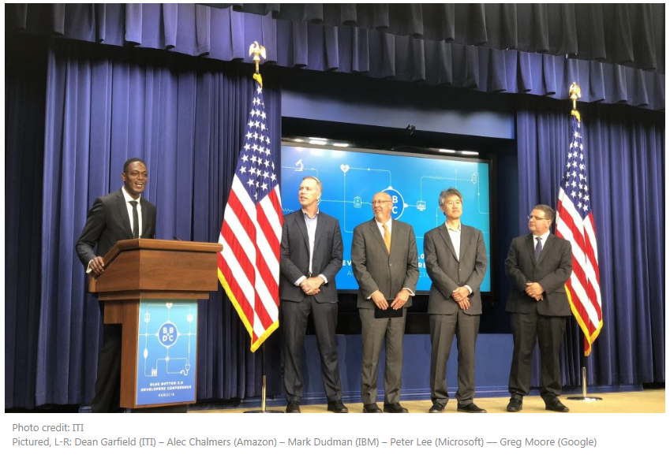
Microsoft, Amazon, Google, IBM, Oracle, and Salesforce issue joint statement for healthcare interoperability
Open standards and open specifications are essential to data exchange.
This requires a ongoing collaboration for the industry to converge and embrace emerging standards for healthcare data interoperability, such as HL7 FHIR and the Argonaut Project.
CMS Blue Button 2.0 Developer Conference , White House
August 13, 2018
https://cloudblogs.microsoft.com/industry-blog/industry/health/microsoft-amazon-google-and-ibm-issue-joint-statement-for-healthcare-interoperability/

Slide 6
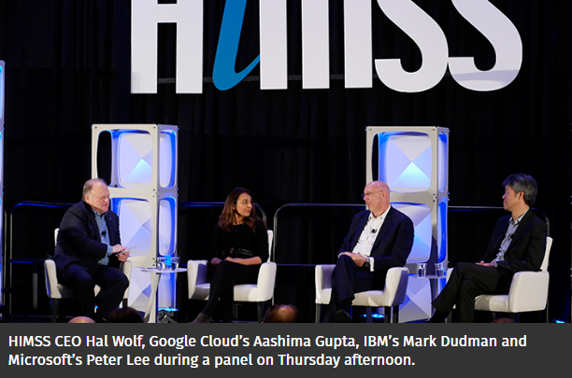
HIMSS19 After interoperability: FHIR is the gateway for AI
Interoperability is the cornerstone of our healthcare strategy — teaching cloud to speak the language of healthcare: HL7 FHIR, DICOM, said Google Cloud
When we see modern data standards like FHIR emerge, it’s obvious this is a part of the democratization of AI, said IBM
FHIR is the gateway to AI and machine learning
February 14, 2019
https://www.healthcareitnews.com/news/after-interoperability-fhir-gateway-ai
Notes:
February 14, 2019
“Interoperability is the cornerstone of our healthcare strategy — teaching cloud to speak the language of healthcare: HL7, FHIR, DICOM,” said Aashima Gupta, Google Cloud
Google, in addition to IBM, Microsoft, Oracle and Salesforce, signed a pledge to remove interoperability barriers back in August 2018 during the Blue Button 2.0 hackathon at the White House
“We’re competitors in many ways but also very much aligned because without interoperability we can’t really make a change and make a difference,” said Mark Dudman, health of global product and AI development at IBM
“When we see modern data standards like FHIR emerge, it’s obvious this is a part of the democratization of AI,” said Peter Lee, Microsoft
“FHIR is the gateway to AI and machine learning,” Gupta said. “We want to to have FHIR in our analytics and machine learning tools.”
https://www.healthcareitnews.com/news/after-interoperability-fhir-gateway-ai

Slide 7
系統整合等級導致產業效率巨大的落差
Interoperability
產業效率
互操作性
雙方採用標準介面
系統互操作性
One Ecosystem
以秒 為單位
A系統
B系統
標準化
雙方採用標準介面
系統互通互連
One Standard
以日 為單位
A系統
B系統
談介接
雙方協調介接介面
系統整合
Case by Case
以月 為單位
A系統
B系統

Slide 8
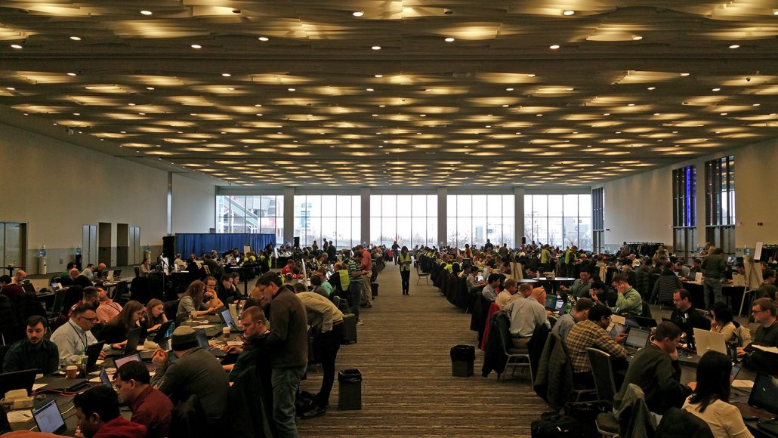
IHE Connectathon Since 2001 FHIR Connectathon Since 2012
形成產官學研共識
並貼合當前市場發展需求現況
標準
發展組織
回饋
市場需求
公佈
籌組
測試
結果
產業標準
聯測會 Connectathon
標準遵從
一致性聲明
測試 系統產品
參考
開發者/廠商
用戶/採購者

Slide 9
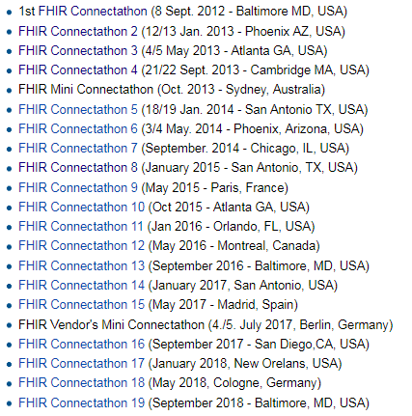
FHIR Connectathon List
http://wiki.hl7.org/index.php?title=FHIR_Connectathon_20

Slide 10
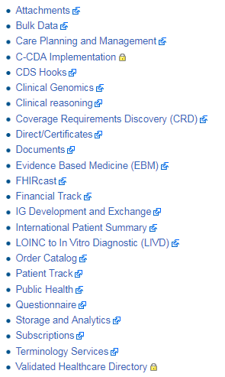
FHIR Connectathon 20 Tracks
照護計畫共享與管理
CDA電子病歷格式轉換
臨床決策支援服務
臨床推論服務(臨床路徑&實證醫學&AI)
FHIR格式電子病歷文件交換(含呈現與簽章)
保險與財務資料互通
國際病患病歷摘要
醫令目錄
病患基本資料
公共衛生
臨床評估量表/問卷
標準化詞彙服務

Slide 11
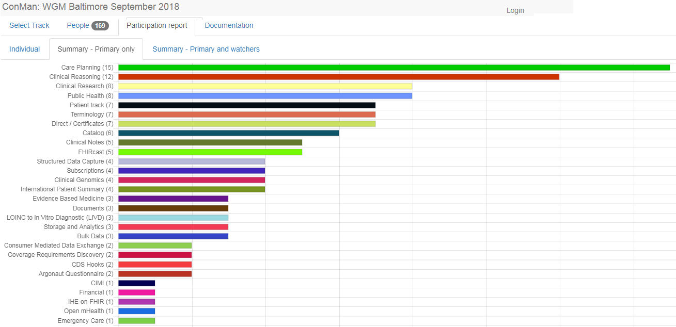
Standard In Active
FHIR Connectathon 19
FHIR Connectathon 1 (2012/9/8 - Baltimore MD, USA) 9 Participants
FHIR Connectathon 2 (2013/1/12 - Phoenix AZ, USA) 12 Participants
FHIR Connectathon 3 (2013/5/4 - Atlanta GA, USA) 13 Participants
FHIR Connectathon 4 (2013/9/21 - Cambridge MA, USA) 23 Participants
FHIR Mini Connectathon (2013/10 - Sydney, Australia)
FHIR Connectathon 5 (2014/1/18 - San Antonio TX, USA) 8 Participants
FHIR Connectathon 6 (2014/1/3 - Phoenix, Arizona, USA) 18 Participants
FHIR Connectathon 7 (2014/9 - Chicago, IL, USA) 18 Participants
FHIR Connectathon 8 (2015/1 - San Antonio, USA) 9 Participants
FHIR Connectathon 9 (2015/5/9, Paris, France) 16 Participants
…
FHIR Connectathon 19 (2018/9/29, Baltimore, USA)
FHIR Connectathon 20 (2019/1/12, San Antonio, USA)
University Health Network James Agnew
Furore Ewout Kramer.
SMART Platforms Josh Mandel
NIST Bill Majurski
IHE & DICOM & Security John Moehrke
Orion Health David Hay.
GE Healthcare Scott Bolte.
Gordon Point Informatics Lloyd McKenzie

Slide 12
FHIR Connectathon 1
http://wiki.hl7.org/index.php?title=FHIR_Connectathon_1
Conformance
Conformance Consumer
Conformance Server
Person
Person Demographics Author
Person Demographics Consumer
Person Demographics Server
Person Demographics Active Tracker
Person Demographics Subscriber
LabReport
LabReport Author
LabReport Server
LabReport Consumer
LabReport Active Tracker

Slide 13
FHIR Connectathon 2
http://wiki.hl7.org/index.php?title=FHIR_Connectathon_2
Actors
…
Scenarios
Register a patient
Submit a document
Find a patient
Find a document

Slide 14
201801 Patient Track
Roles
FHIR Client
FHIR Server
Scenarios
Level 1 - Introduction - New Participants/Systems
1. Register a new patient
2. Update a patient
3. Retrieve Patient history
4. Search for a patient on name
5. Delete a patient
Level 2 - Formal Testing - Participants with FHIR experience

Slide 15
201805 CarePlan Track
Roles
FHIR Server
FHIR Knowledge Asset Server
Care Plan Protocol Creator
CDS Service Requestor
Scenarios
Retrieve a patient's care plan(s)
Create new care plan from protocol definition
Request CDS 'patient-view' hook
Return include any combination of information (for reading), suggested actions (to be applied if a user selects them), and links (to launch an app if the user selects them)
Participants:
Allscripts
Book Zurman
Clinical Cloud Solutions
InterSystems
Motive Medical Intelligence
Veterans Health Administration (VHA)

Slide 16
Taiwan FHIR Connectathon Suggestion
2019
Conformance
Patient
LabReport
Image Report Workflow
ImagingStudy / Observation / DiagnoticReport
2020
Person
Condition
Medication
Device

Slide 17

2019年國際醫學資訊聯合研討會

Slide 18

Thank You
台灣醫學資訊學會秘書長
李祥豪 02-22250891-501
leesh@datacom.com.tw
聯絡方式：
235 新北市中和區中正路866號15樓
Tel:(02)2225-0891 Fax:(02)2225-0896 http://www.datacom.com.tw

